Slide 1
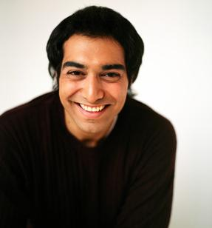
1-3 PRONOUN + BE + NOUN
He is a teacher.

Slide 2
1-3 PRONOUN + BE + NOUN
SINGULAR
I am a teacher.
You are a teacher.
She is a teacher.
He is a teacher.
It is a school.
PLURAL
We are teachers.
You are teachers.
They are teachers.

Slide 3
1-3 PRONOUN + BE + NOUN
SINGULAR
I am a teacher.
You are a teacher.
She is a teacher.
He is a teacher.
It is a school.
PLURAL
We are teachers.
You are teachers.
They are teachers.

Slide 4
1-3 PRONOUN + BE + NOUN
SINGULAR
I am a teacher.
You are a teacher.
She is a teacher.
He is a teacher.
It is a school.
PLURAL
We are teachers.
You are teachers.
They are teachers.

Slide 5
1-3 Let’s Practice
SINGULAR
I ___________.
You ___________ .
She___ _______ .
PLURAL
am a student
We ___________ .
You __________ .
They __________ .
are students
are a student
are students
is a student
are students

Slide 6

1-4 CONTRACTIONS WITH BE
She´s a teacher.

Slide 7
1-4 CONTRACTIONS WITH BE
PRONOUN + BE
CONTRACTION
AM
I + am I’m
I’m a teacher.

Slide 8
1-4 CONTRACTIONS WITH BE
PRONOUN + BE
CONTRACTION
she + is she’s
IS
he + is he’s
it + is it’s
He’s a boy.
She’s a girl.
It’s a cat.

Slide 9
1-4 CONTRACTIONS WITH BE
PRONOUN + BE
CONTRACTION
you + are you’re
ARE
we + are we’re
they + are they’re
They’re students.
We’re students.
You’re students.

Slide 10

1-4 Let’s Practice
I have two sisters.
______ students.
We’re

Slide 11
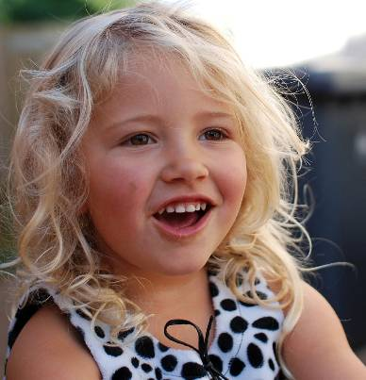
1-5 NEGATIVE WITH BE
I am not a teacher.

Slide 12
1-5 NEGATIVE WITH BE
CONTRACTIONS
She’s not
She isn’t
He’s not
He isn’t
I’m not
You’re not
You aren’t
(a) I am not a doctor.
(b) You are not a doctor.
(c) She is not a doctor.
(d) He is not a doctor.

Slide 13
1-5 NEGATIVE WITH BE
CONTRACTIONS
They’re not
They aren’t
You’re not
You aren’t
It’s not
It isn’t
We’re not
We aren’t
(e) It is not a city.
(f ) We are not doctors.
(g) You are not teachers.
(h) They are not teachers.

Slide 14

1-5 Let’s Practice
isn’t aren’t
The women ______ nurses.
aren’t
they doctors
They’re doctors
______________.

Slide 15
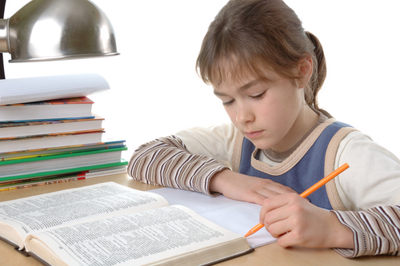
1-5 Let’s Practice
isn’t aren’t
This girl ____ a teacher.
isn’t
she student
She’s a student
______________.

Slide 16
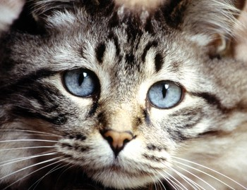
1-5 Let’s Practice
isn’t aren’t
This animal _____ a dog.
isn’t
it cat
_________.
It’s a cat

